Slide 1

Search Techniques

Slide 2
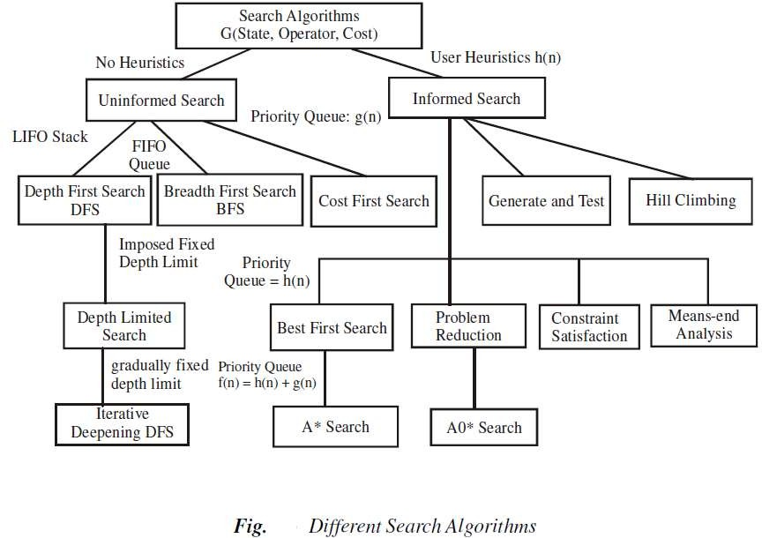

Slide 3
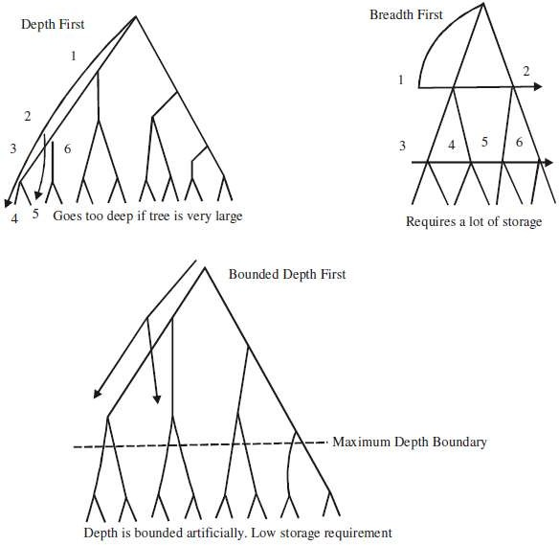

Slide 4
Heuristic Search Techniques

Slide 5
Heuristics
A heuristic is a method that improves the efficiency of the search process.
Some heuristics help in the search process without sacrificing any claims and occasionally cause an excellent path to be overlooked.
Heuristics may not find the best solution every time but guarantee that they find a good solution in a reasonable time.
These are particularly useful in solving tough and complex problems, solutions of which would require infinite time.

Slide 6
Heuristic search
‘A heuristic function maps a problem state descriptions to a measures of desirability(represented as numbers).
Heuristic search methods use knowledge about the problem domain, choose promising operators and heuristic functions to evaluate the next state towards the goal state.
For finding a solution, steps involved:
Add domain—specific information to select what is the best path to continue searching along.
Define a heuristic function h(n) that estimates the ‘goodness’ of a node. Specifically, h(n) = estimated cost(or distance) of minimal cost path from n to a goal state.
Example :
Finding a route from one city to another city.

Slide 7
Heuristic search techniques
A framework for describing search methods is provided and several general purpose search techniques are discussed.
All are varieties of Heuristic Search:
  Generate and test
  Hill Climbing
  Best First Search
  A* Algorithm

Slide 8
Generate-and-Test
Algorithm
Generate a possible solution.
Test to see if this is actually a solution.
Quit if a solution has been found. Otherwise, return to step 1.

Slide 9
Generate-and-Test
Acceptable for simple problems.
Inefficient for problems with large space.

Slide 10
Generate-and-Test
Exhaustive generate-and-test.
Heuristic generate-and-test: not consider paths that seem unlikely to lead to a solution.
Plan generate-test:
C−reate a list of candidates.
A−pply generate-and-test to that list.

Slide 11
Generate-and-Test
Example: coloured blocks
“Arrange four 6-sided cubes in a row, with each side of each cube painted one of four colours, such that on all four sides of the row one block face of each colour is showing.”
Heuristic: if there are more red faces than other colours then, when placing a block with several red faces, use few of them as possible as outside faces.

Slide 12
Generate-and-Test
•
It is a depth first search procedure since complete solutions must be generated before they can be tested.
In its most systematic form, it is simply an exhaustive search of the problem space.
Operate by generating solutions randomly. Also called as British Museum algorithm
If a sufficient number of monkeys were placed in front of a set of typewriters, and left alone long enough, then they would eventually produce all the works of shakespeare.
Dendral: which infers the struture of organic compounds using NMR spectrogram. It uses plan-generate-test.
•
•
•
•
•

Slide 13
Hill Climbing
Searching for a goal state = Climbing to the top of a hill
Generate-and-test + direction to move.
Heuristic function to estimate how close a given state is to a goal state.

Slide 14
Simple Hill Climbing
Algorithm
Input: START & GOAL states
Variables: OPEN, NODE, SUCCs, FOUND
Output: Yes / No
Method:
Store initially the start node in a OPEN list(maintained as stack), FOUND=False
While ( OPEN≠empty and FOUND=false)
{
remove the top element from OPEN list and call it NODE
if NODE is goal then FOUND = true
else
find SUCCs of NODE. If any:
sort SUCCs by estimated cost from NODE to goal state and add them to the front of OPEN list.
}
If FOUND= true then return Yes otherwise NO

Slide 15
Simple Hill Climbing
Evaluation function as a way to inject task-specific knowledge into the control process.
Example: coloured blocks
Heuristic function: the sum of the number of different colours on each of the four sides (solution = 16).

Slide 16
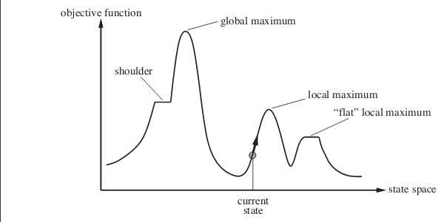
General trace of heuristic function

Slide 17
Hill Climbing : Issues
Local Maximum : It is a state that is better than all its neighbours but not better than some other states.
Plateau : It is a flat area of the search space where all neighbouring states has the same value.
Ridge: It is an area of search space that is higher than surrounding areas but that cannot be traversed by single move in any one direction.

Slide 18

Hill Climbing: Disadvantages
Local maximum
A state that is better than all of its neighbours, but not better than some other states far away.

Slide 19
Hill Climbing: Disadvantages
Plateau
A flat area of the search space in which all neighbouring states have the same value.

Slide 20
Hill Climbing: Disadvantages
Ridge
The orientation of the high region, compared to the set of available moves, makes it impossible to climb up.
However, two moves executed serially may increase the height.

Slide 21
Hill Climbing: Disadvantages
Ways to overcome
Backtrack to some earlier node and try going in a different direction.
Make a big jump to try to get in a new section.
Moving in several directions at once.

Slide 22
Hill Climbing: Disadvantages
Hill climbing is a local method:
Decides what to do next by looking only at the “immediate” consequences of its choices.
Global information might be encoded in heuristic functions.

Slide 23
Hill Climbing: Disadvantages
Start
Goal
 | A
 | D
 | C
 | B
 | D
 | C
 | B
 | A
Blocks World

Slide 24
Hill Climbing: Disadvantages
Start
0
Goal
4
 | A
 | D
 | C
 | B
 | D
 | C
 | B
 | A
Blocks World
Local heuristic:
+1 for each block that is resting on the thing it is supposed to be resting on.
−1 for each block that is resting on a wrong thing.

Slide 25
Hill Climbing: Disadvantages
0
2
 | A
 | D
 | C
 | B
D
C
B A

Slide 26
Hill Climbing: Disadvantages
D
2
C
B A
0
0
 | A | 0
 | D
 | C
 | B
 | C |  | D
 | B |  | A
 | C
 | B |  | A |  | D

Slide 27
Hill Climbing: Disadvantages
Start
−6
Goal
6
 | A
 | D
 | C
 | B
 | D
 | C
 | B
 | A
Blocks World
Global heuristic:
For each block that has the correct support structure: +1 to
every block in the support structure.
For each block that has a wrong support structure: −1 to
every block in the support structure.
24

Slide 28
Hill Climbing: Disadvantages
D
−3
C
B A
−2
−1
 | A | −6
 | D
 | C
 | B
 | C |  | D
 | B |  | A
 | C
 | B |  | A |  | D

Slide 29
Hill Climbing: Conclusion
Can be very inefficient in a large, rough problem space.
Global heuristic may have to pay for computational complexity.
Often useful when combined with other methods, getting it started right in the right general neighbourhood.

Slide 30
Best-First Search
Depth-first search: not all competing branches having to be expanded.
Breadth-first search: not getting trapped on dead-end paths.
⇒ Combining the two is to follow a single path at a time, but switch paths whenever some competing path look more promising than the current one.

Slide 31
Best-First Search
A
A
A
B
C
D
B
C
D
3
5
1
3
5
E
F
4
6
A
A
B
C
D
B
C
D
_{H} 5
_{H} 5
G
E
F
G
E
F
6
5 4
6
6
5 _{I}
6
J
2
1

Slide 32
Best-First Search
OPEN: nodes that have been generated, but have not examined.
This is organized as a priority queue.
CLOSED: nodes that have already been examined.
Whenever a new node is generated, check whether it has been generated before.

Slide 33
BEST FIRST SEARCH
Algorithm
Input: START & GOAL states
Variables: OPEN, COLSED, SUCCs, FOUND
Output: Yes / No
Method:
Initialize OPEN list by root node, FOUND=False, CLOSED= φ
While ( OPEN≠ φ and FOUND= false)
{
if NODE is goal then FOUND = true
else
remove if from OPEN list and put it in CLOSED list
add its SUCCs If any in OPEN List:
Sort entire list by the value of some heuristic function that assigns each node, the estimate to reach to the goal node.
}
If FOUND= true then return Yes otherwise NO

Slide 34
Best-First Search
Greedy search:
h(n) = estimated cost of the cheapest path from node n to a goal state.
Uniform-cost search:
g(n) = cost of the cheapest path from the initial state to node n.

Slide 35
Best-First Search
Greedy search:
h(n) = estimated cost of the cheapest path from node n to a goal state.
Neither optimal nor complete
Uniform-cost search:
g(n) = cost of the cheapest path from the initial state to node n.
Optimal and complete, but very inefficient

Slide 36
Best-First Search
Algorithm A* (Hart et al., 1968):
f(n) = g(n) + h(n)
h(n) = cost of the cheapest path from node n to a goal state.
g(n) = cost of the cheapest path from the initial state to node n.

Slide 37
A* Approach
Algorithm A*:
f*(n) = g*(n) + h*(n) h*(n) (heuristic factor) = estimate of h(n).
g*(n) (depth factor) = approximation of g(n) found by A* so far.

Slide 38
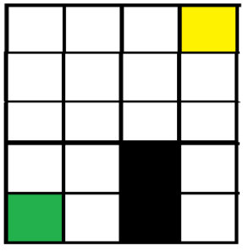
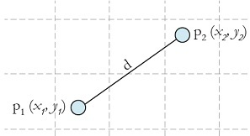
EXAMPLE
A* expands paths that are already less expensive by using this function:
f(n) = g(n) + h(n)
f(n) = total estimated cost of path through node n.
g(n) = cost so far to reach node n.
h(n) = estimated cost from n to goal.
$$h(n)=\sqrt{{\left(\begin{matrix}x_{2} & − & x_{1}\end{matrix}\right)}^{2}\begin{matrix}+ & {\left(\begin{matrix}y_{2} & − & y_{1}\end{matrix}\right)}^{2}\end{matrix}}$$

Slide 39
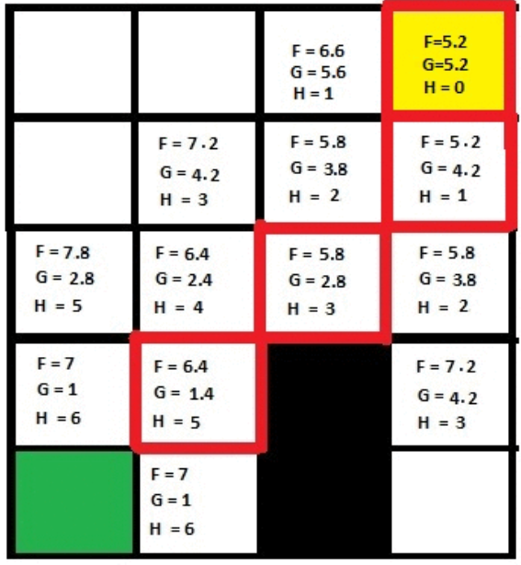
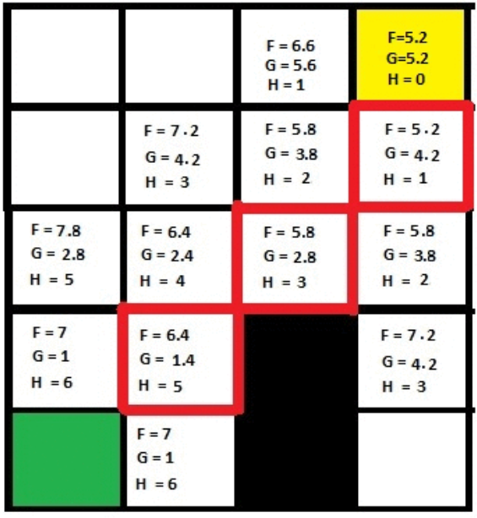
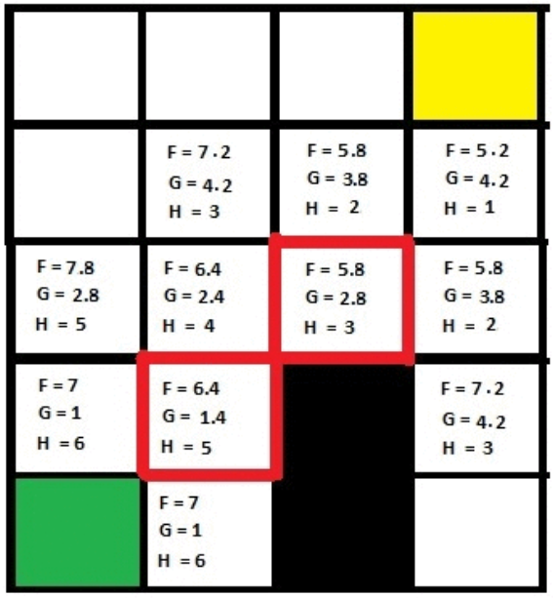
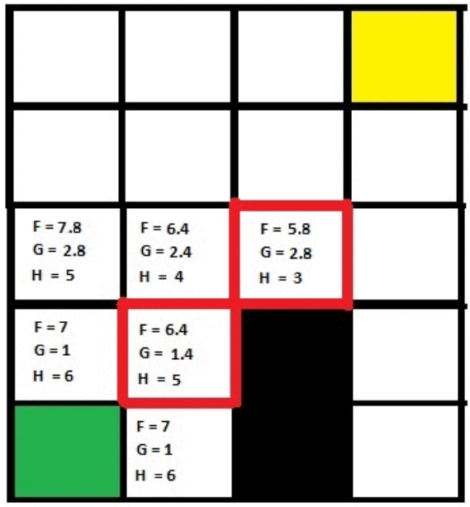
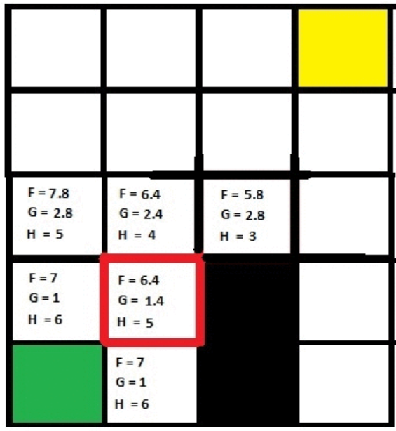
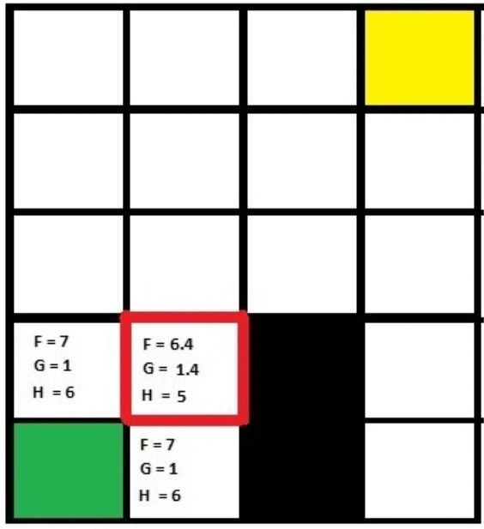
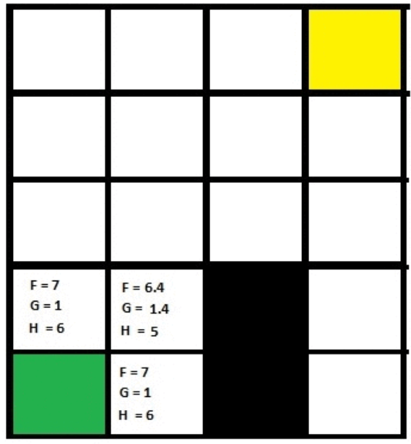
Example

Slide 40
A* Algorithm
make an openlist containing only the starting node
make an empty closedlist
while (the destination node has not been reached):
consider the node with the lowest f score in the openlist
if (this node is our destination node) : finished
else:
put the current_node in the closedlist and look at all of its neighbors
for (each neighbor of the current_node):
if (neighbor has lower g value than current and is in the closedlist) :
replace the neighbor with the new, lower, g value
current_node is now the neighbor's parent
else if (current g value is lower and this neighbor is in the openlist ) :
replace the neighbor with the new, lower, g value
change the neighbor's parent to our current_node
else if this neighbor is not in both lists:
add it to the openlist and set its g

Slide 41
Observations about A*
Role of g function: This lets us choose which node to expand next on the basis of not only of how good the node itself looks, but also on the basis of how good the path to the node was.
h’, the distance of a node to the goal.If h’ is a perfect estimator of h, then A* will converge immediately to the goal with no search.

Slide 42
Thank you

